Slide 1
Flycycle Summer Update

Slide 2
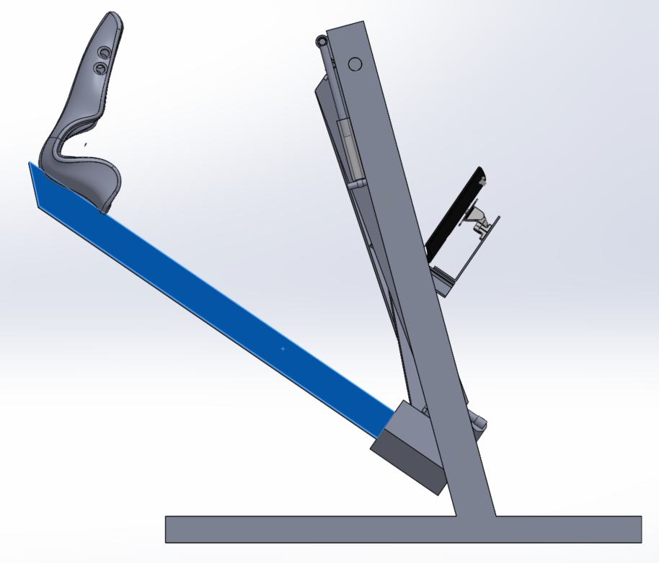
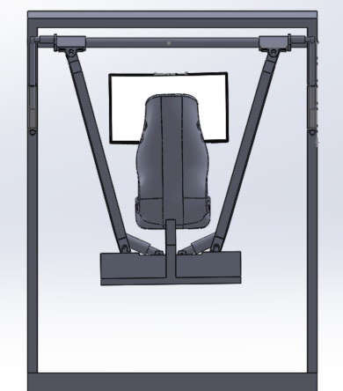
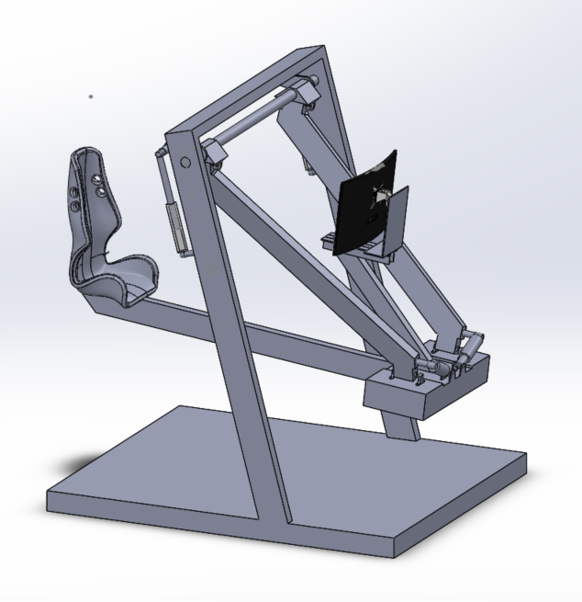
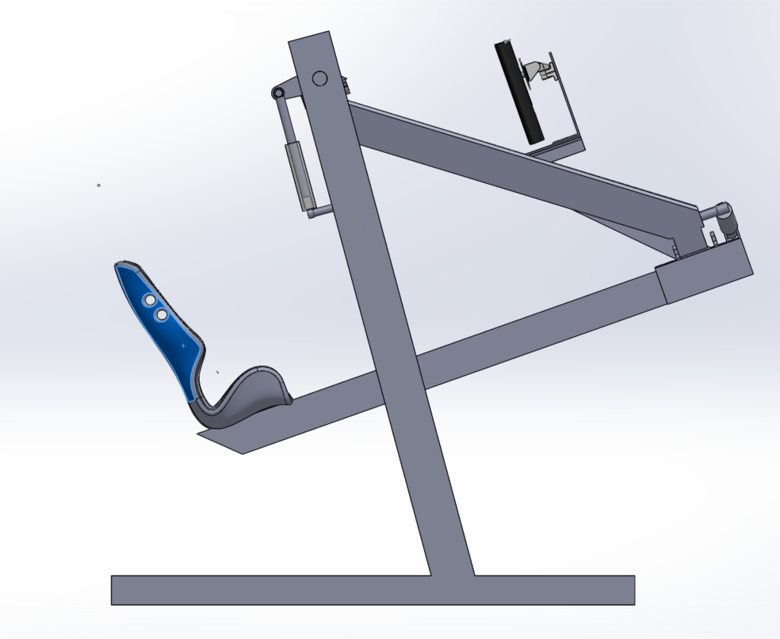
Cad Design for the Flycycle

Slide 3
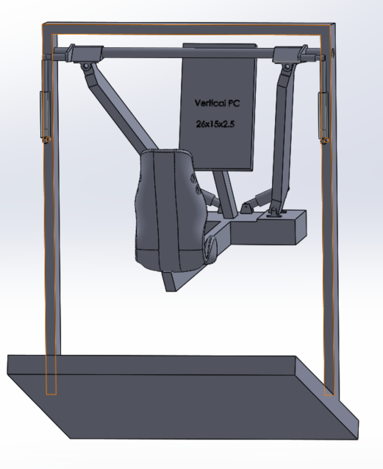
Monitor Selection
Vertical PC
26x16.5 28 in

Slide 4
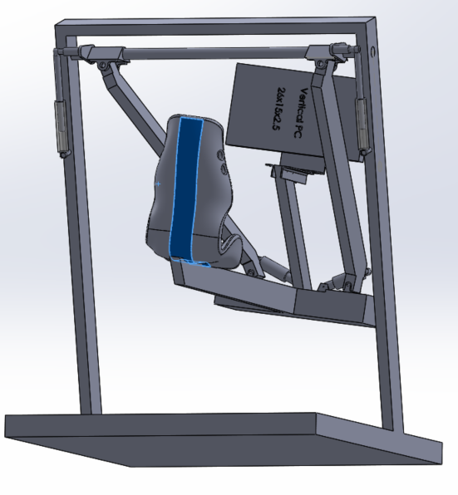
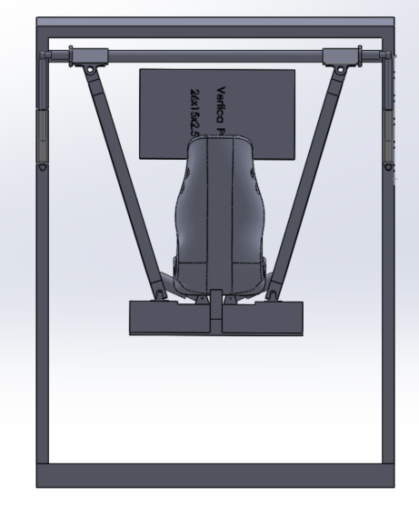
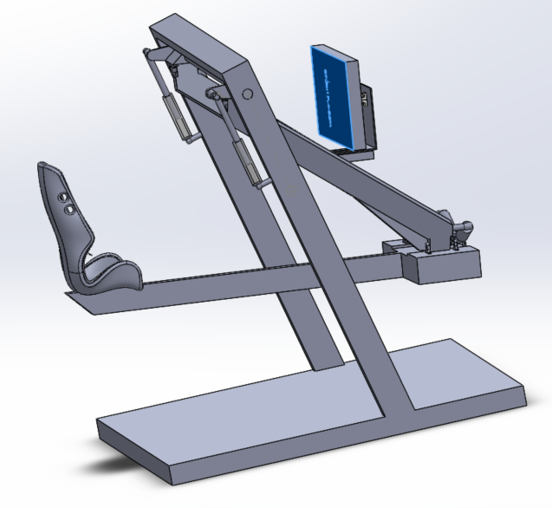
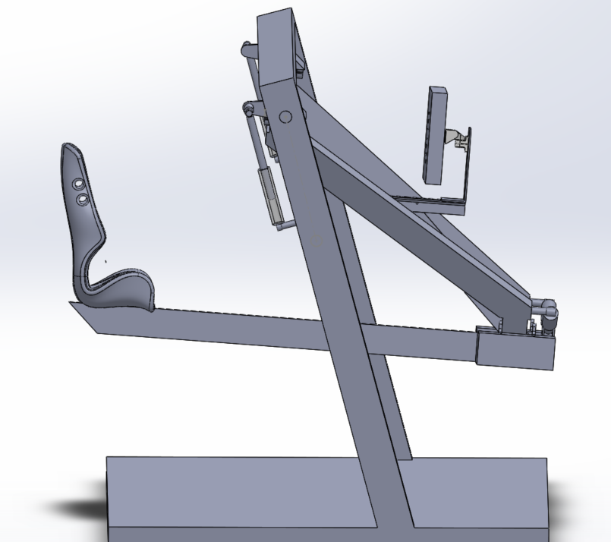
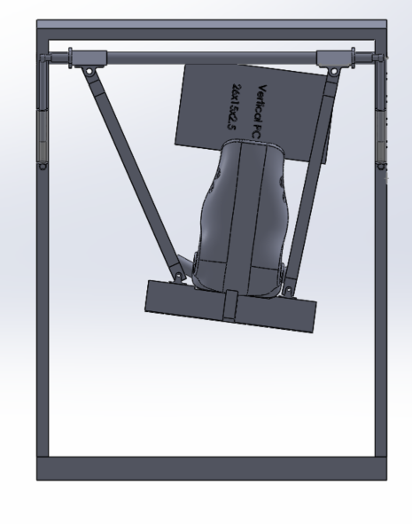
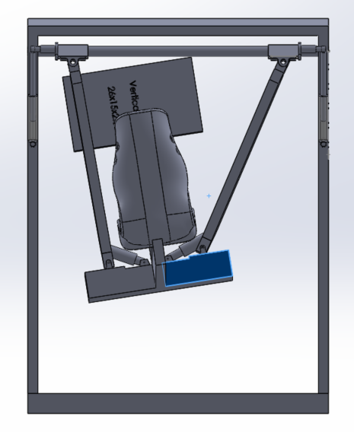
Same Size Horizontal PC
Horizontal PC
26x16.5 in – 28In
Clearance= 12cm

Slide 5
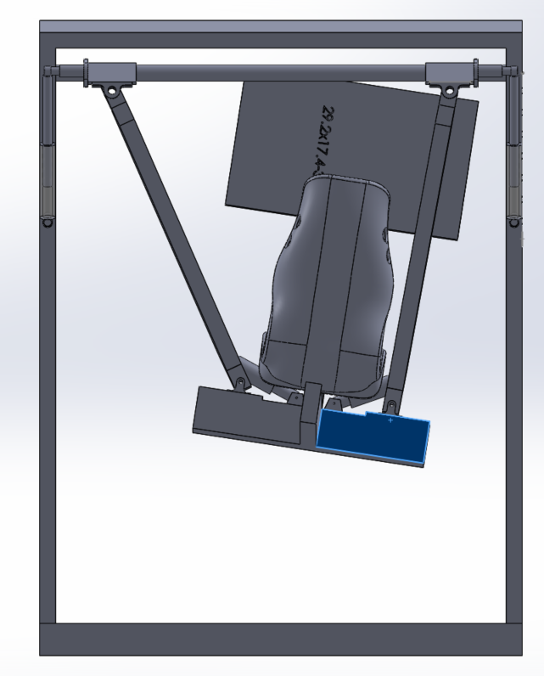
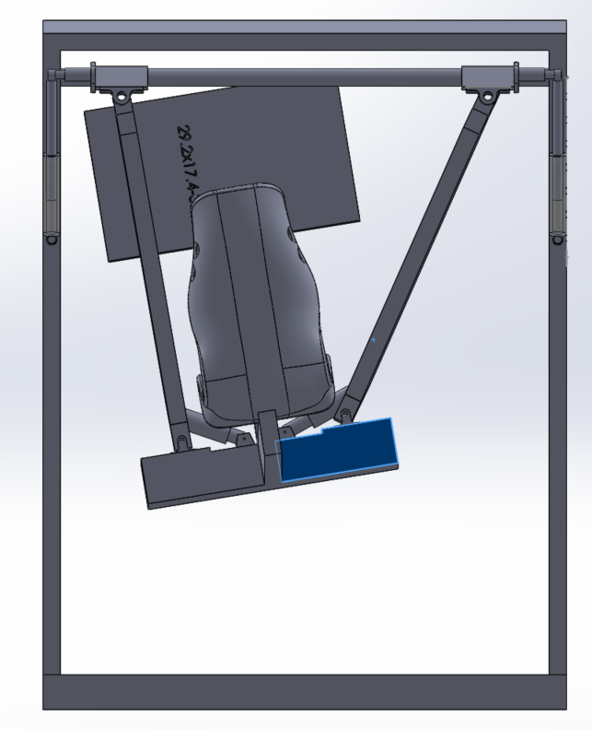
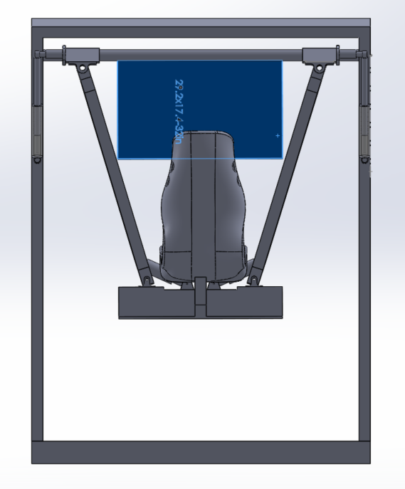
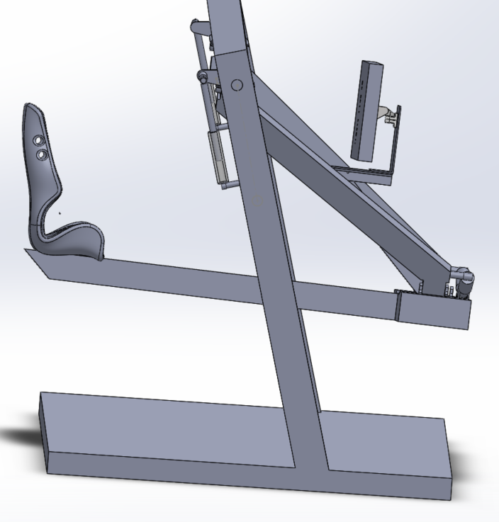
32 In
Horizontal PC
29x17.4 in – 32 In
Rigid support bolts are available.
Clearance= 8cm

Slide 6
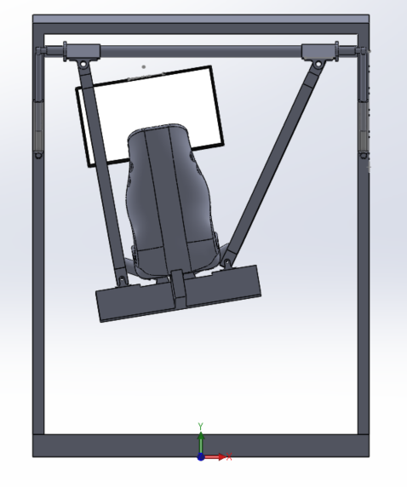
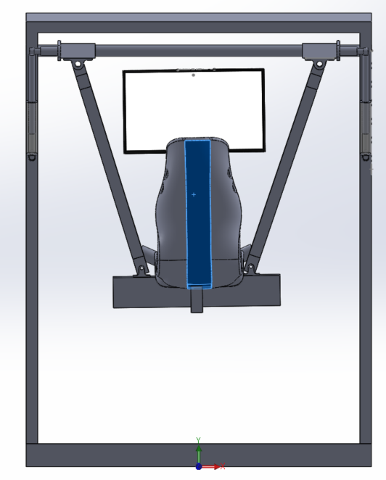
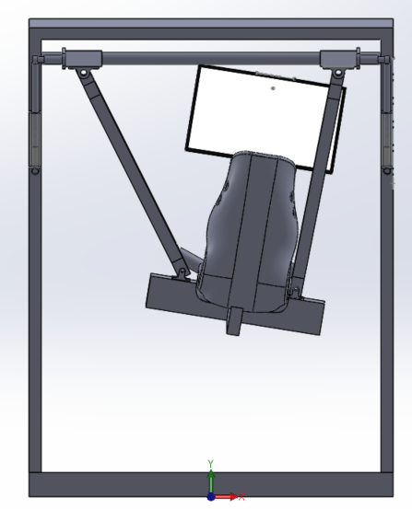
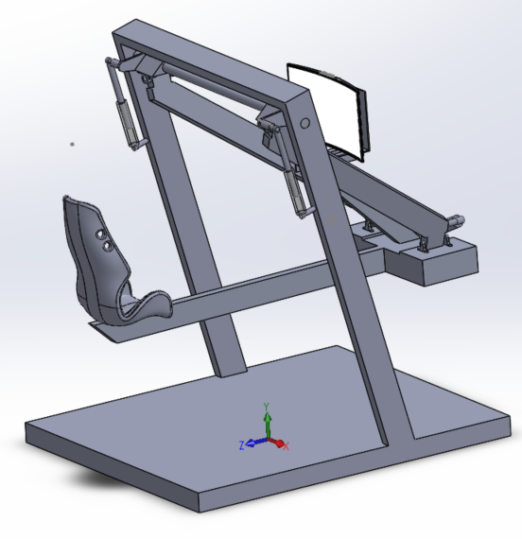
Curved 27 in
Horizontal PC
26x15 in – 27 In
Rigid support bolts are available.
32In curved have very large width. Would not work very well.
In tv, curve start from 55. (not possible).
Clearance= 21 cm

Slide 7
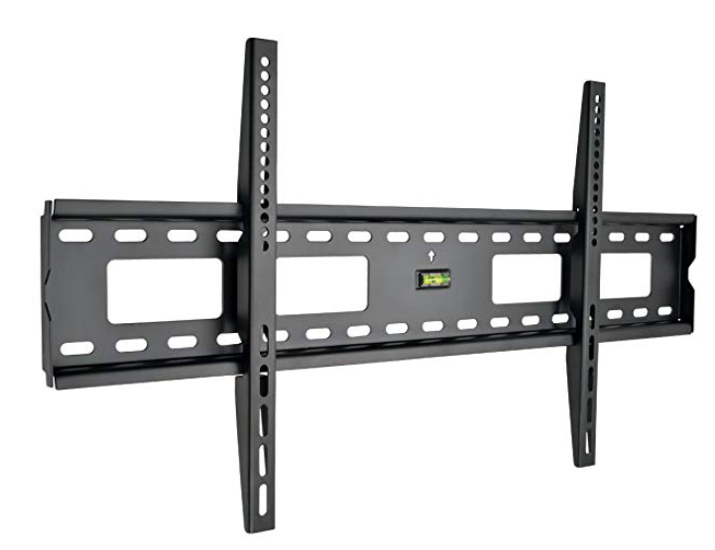
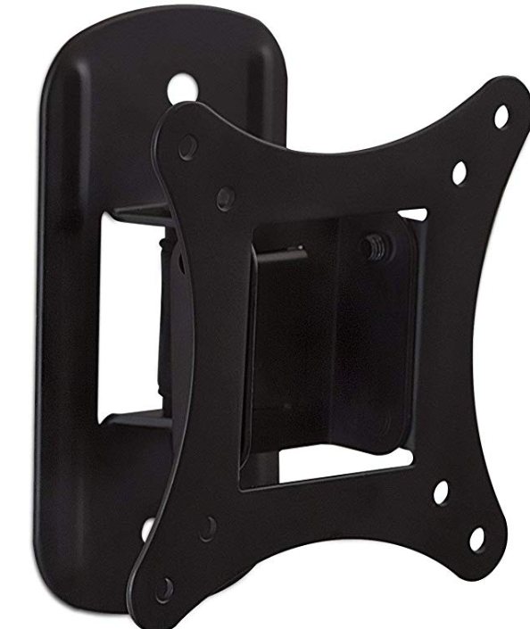
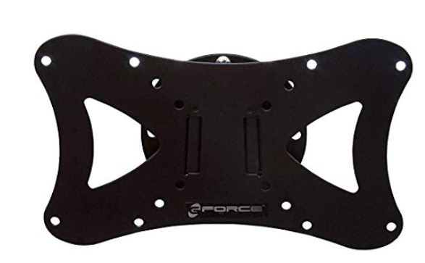
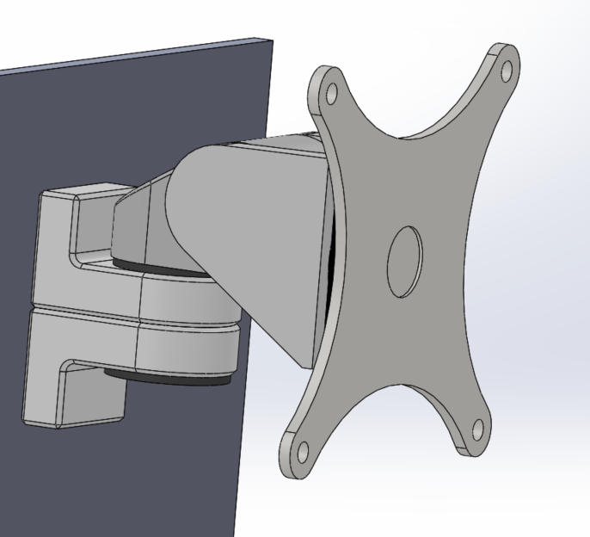
Monitor Mount (Example)

Slide 8
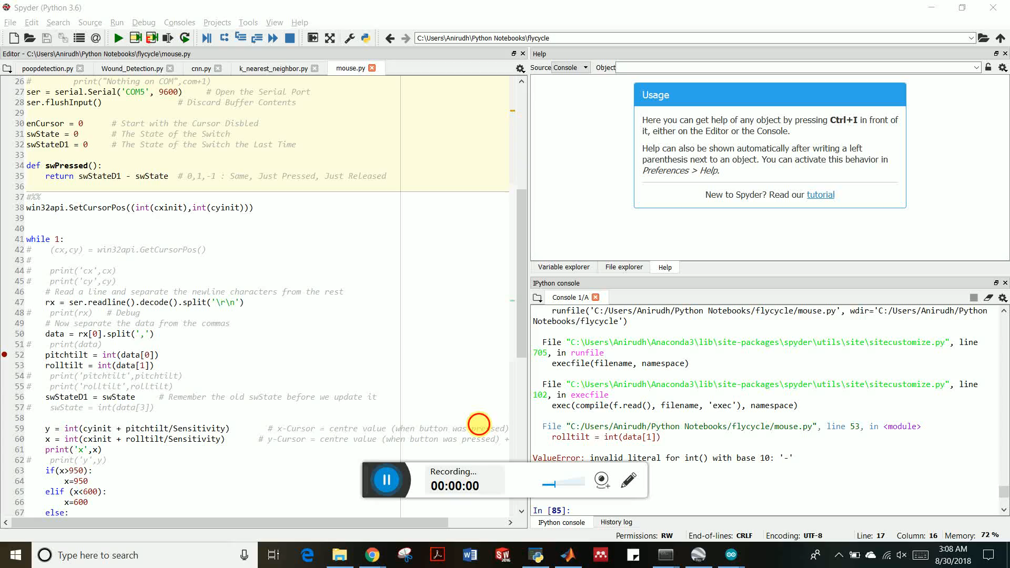
Simulation on a Flight Simulator
https://www.youtube.com/watch?v=XNBFAa-0rEA&t=3s

Slide 9
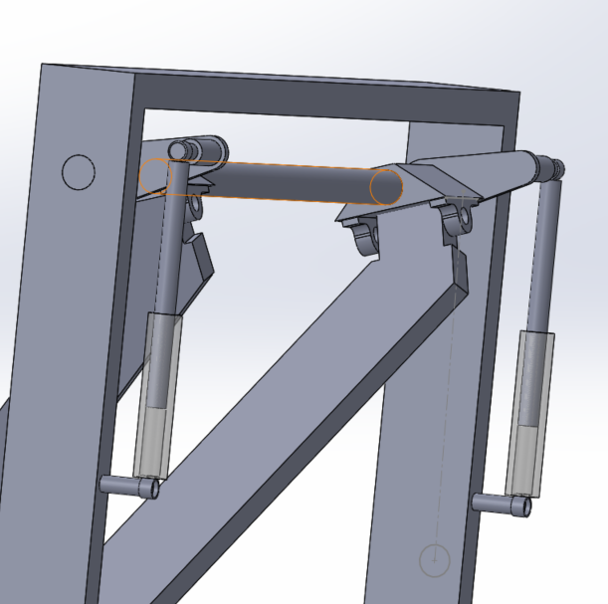
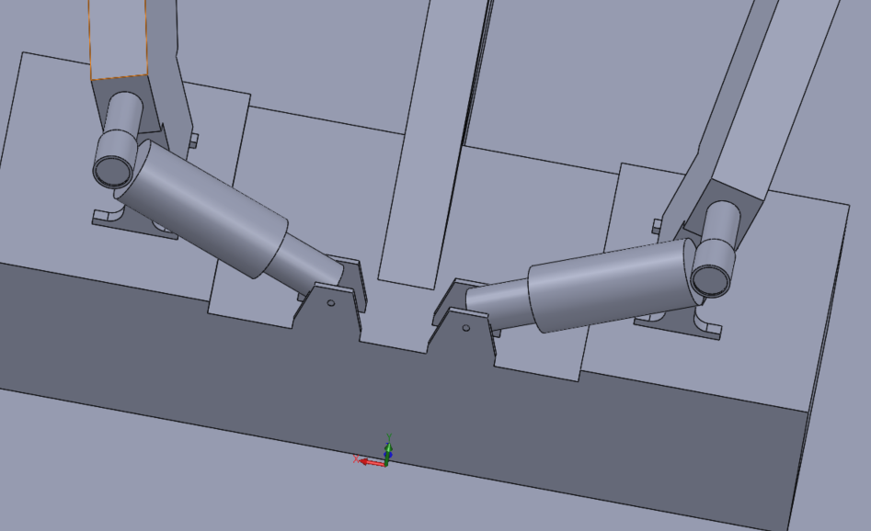
Actuating the Flycycle
Pitch Actuation Roll Actuation

Slide 10
Next Set of Objectives
Interface Flycycle with Xbox controller so that it can be used with any other game.
Interfacing the Flycycle with Oculus Rift (VR).
Piston Brakes when no pedaling.
Developing games in unity.
Figure out a way to actuate the Flycycle.

Slide 11
Things Needed
Design Drawing for the Flycycle to get the exact Dimensions.
Hydraulic Piston for brakes and get extra if available.

Slide 12

Thank You!!

